Slide 1


PENS & PRINTERS
PENS & PRINTERS
PRODUCT SALES ANALYSIS
BY
Harold-Wilson Thom-Otuya

Slide 2

PENS & PRINTERS
OVERVIEW
Purpose: The primary goal of this project is to identify the most effective sales strategies for Pens and Printers' new product line, in response to evolving consumer behaviors. This involves analyzing sales data to determine which methods generate the most revenue, understanding customer retention trends, and providing actionable recommendations to optimize sales performance.
Scope: The analysis focuses on three sales methods—Email, Call, and Email + Call—over a six-week period. It examines revenue distribution by sales method, revenue trends over time, customer retention based on tenure, and the impact of each method on different customer segments.
Hence, we answer the following questions to understand the
○ How many customers were there for each sales approach ?
○ What does the spread of the revenue look like overall and for each sales method?
○ Was there any difference in revenue over time for each of the methods?
○ Based on the data, which method would you recommend we continue to use?

Slide 3
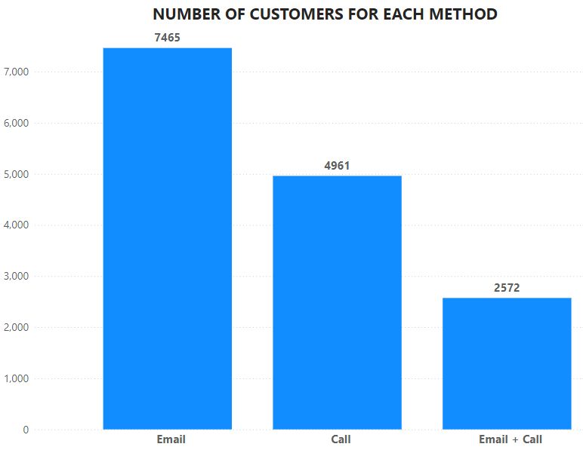
PENS & PRINTERS
OUTCOME: Customers For Each Sales Method.
From the last 6 weeks, the number of customers for each sales method i identified is as follows:
The Email method has the most customers, with 7,465.
The Call method comes in with 4,961 customers.
The Email + Call method has the fewest, with 2,572 customers.

Slide 4
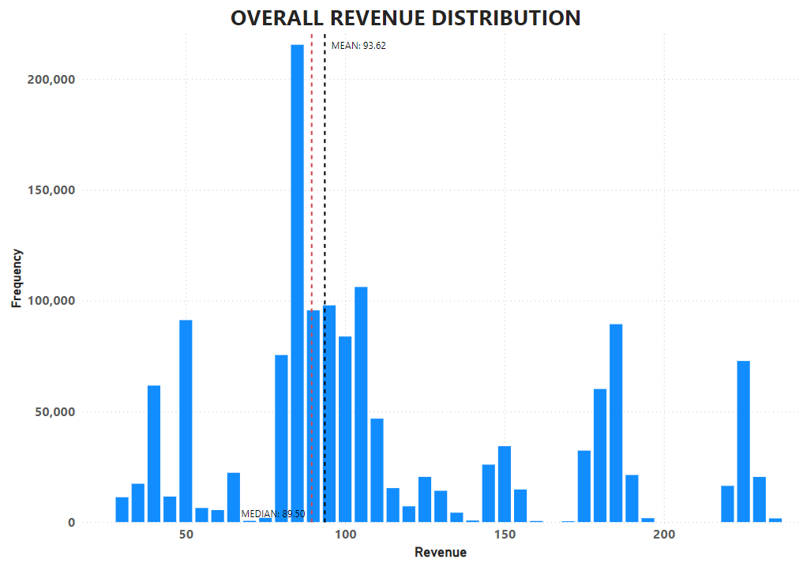
PENS & PRINTERS
OUTCOME: Revenue Distribution Analysis
The most striking feature of the graph is the concentration of revenue values around a central point. Most of the data clusters between approximately $80 to $100 in revenue, with a particularly sharp peak around $90. This indicates that a large portion of the revenue observations fall within this range, making it a critical area of focus.
There are noticeable spikes at higher revenue values, particularly around $150, $180, and $190. These spikes could suggest specific revenue brackets that occur more frequently, possibly due to certain pricing strategies, product categories, or customer segments.
Learn More

Slide 5
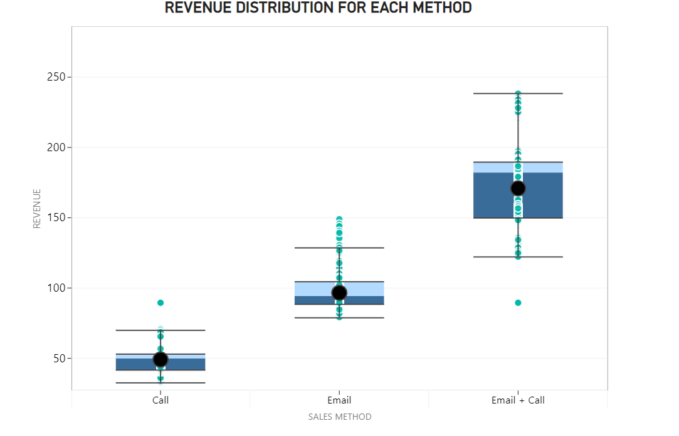
PENS & PRINTERS
OUTCOME: Revenue distribution by sales method.
The Email + Call method stands out for its wider range and higher median revenue of $182 . It seems to be the most effective for generating higher sales since 50% of it revenue is between $150 - $190, with more variation indicating that this combined approach can capture a broad range of customer transactions, including some significantly higher-value ones.
The Call method appears to generate the lowest and most consistent revenue, with little variation and a few outliers. This could indicate that phone calls may be more effective for smaller, more straightforward transactions.
The Email method generates slightly higher revenue on average and has a bit more variation.

Slide 6
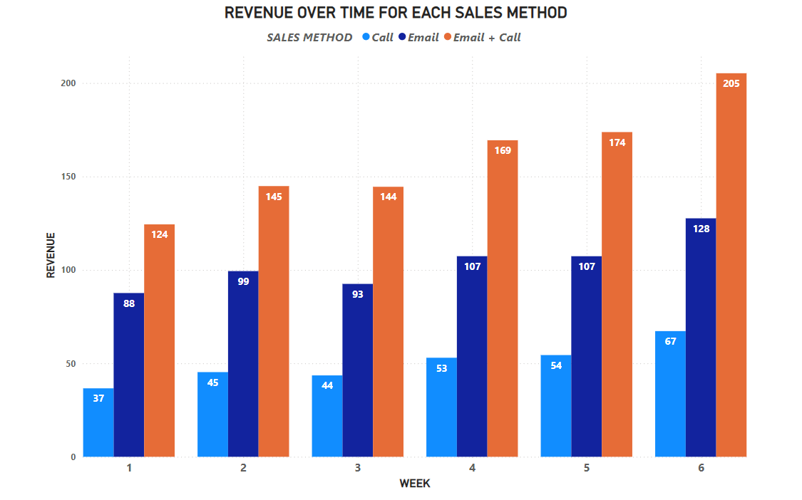
PENS & PRINTERS
OUTCOME: Revenue trends over six weeks for each sales method.
Overall, there was a clear difference in revenue trends across the three methods. The Email + Call method consistently generated the highest revenue and showed continuous growth, making it the most effective approach over time. The Email method performed averagely well. Meanwhile, the Call method generated the least revenue, indicating that phone calls alone might not be sufficient to drive substantial sales.

Slide 7
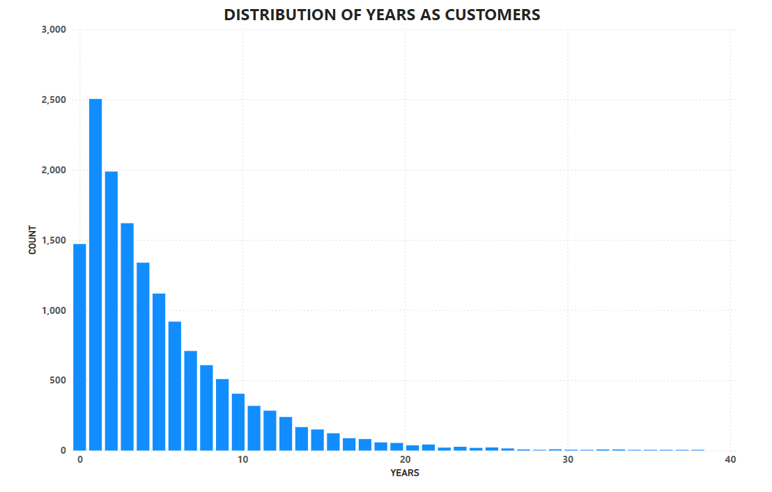
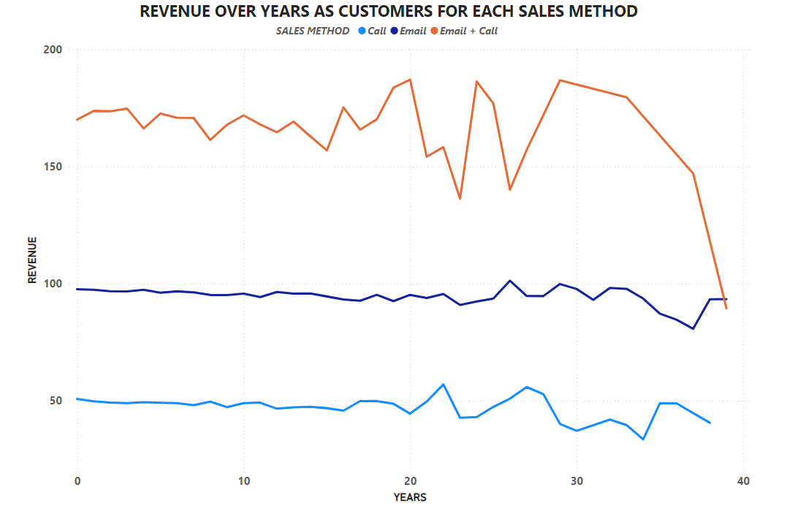
PENS & PRINTERS
OUTCOME: Customers Analysis.
The histogram below shows that Pens and Printers has successfully attracted a large number of new customers, particularly those who have been with the company for less than two years,
However, there is a noticeable decline in customer numbers as the years increase, with significantly fewer customers remaining after 10 years, and even fewer beyond 20 years.
This pattern highlights the typical challenges of customer retention over time. Despite this, the company does have a small but loyal group of long-term customers who have stayed for over 20 years, representing a valuable segment that should be nurtured.
This graph highlights that the Email + Call method is the most effective in generating higher revenue, especially with customers who have been with the company for up to 30 years.
The Email method provides a stable, reliable revenue stream across all customer age groups, making it a solid choice for consistent engagement.
Meanwhile, the Call method, while less effective overall, might still have its place in specific contexts or with certain customer segments, but it’s clear that calls alone are not enough to drive substantial sales, especially with more established customers.

Slide 8
PENS & PRINTERS
KEY FINDING AND BUSINESS METRIC.
Based on the data, I would recommend we keep using the Email + Call method. It consistently brought in the highest revenue across the board, which shows it is really effective.This method also captures higher-value sales,
This suggests that combining email with a follow-up call can effectively drive more significant sales, appealing to a broader range of customers, including those making larger purchases.
Business Metric to Monitor
Given that the business goal is to identify the most effective sales approach for the new product line in response to changing consumer behavior, I recommend we focus on tracking the percentage of average sales revenue generated by each sales method. Although the Email + Call method has consistently brought in the highest revenue, it's important to monitor the performance of all methods to determine what works best over time.
By tracking the percentage of average sales revenue across all methods, we can better understand which strategies are most effective in different contexts and for different customer segments. This metric will allow us to spot trends and patterns, helping us make more informed decisions about how to optimize the sales strategies moving forward.
Based on the data from the past six weeks, the percentage of average sales revenue for each method is as follows:
Email + Call: 53.98%
Email: 30.51%
Call: 15.51%
These figures highlight the effectiveness of the Email + Call method, but also the importance of continuing to track and evaluate all methods to ensure we're using the best approach for our customers.
Learn More

Slide 9
PENS & PRINTERS
RECOMMENDATION
I recommend that the following should be implemented to increase the overall business Performance
Tracking the percentage of average sales revenue for each method over time will help us understand the evolving effectiveness of each strategy.As customer behaviors and market conditions change, it’s important to regularly review the effectiveness of each sales method.
Focus on the Email + Call strategy for key customer segments and important campaigns.
Utilize the Email method for customer segments where the additional effort of a call may not significantly increase sales. This method is reliable and less resource-intensive, making it suitable for maintaining steady sales.
Develop and implement strategies aimed at improving long-term customer retention. This could include loyalty programs, personalized offers, or targeted communications that address the specific needs of customers who have been with the company for a longer time.
Consider investing in tools or research that provide deeper insights into customer behavior and preferences, particularly for long-term customers
As the company implements these strategies, it’s important to track progress and celebrate successes, both small and large.
Finally, be proactive in anticipating future challenges

Slide 10

PENS & PRINTERS
THANK YOU
PENS & PRINTERS
PRODUCT SALES ANALYSIS

